Slide 1
Support Vector Machines (contd)
CS771: Introduction to Machine Learning
Piyush Rai

Slide 2
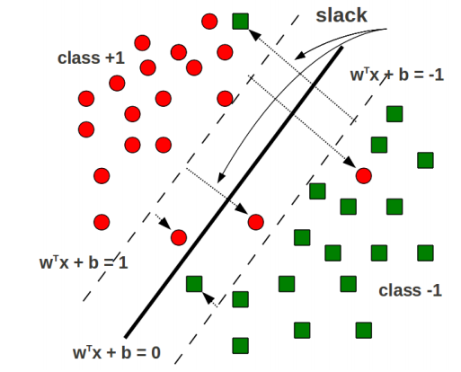
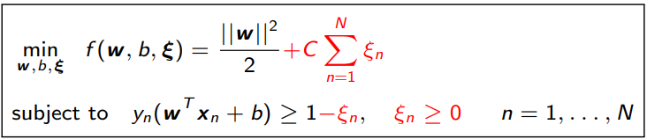

Soft-Margin SVM
Goal: Still want to maximize the margin such that
Soft-margin constraints ${y_{n}(w}^{⊤}x_{n}+b)≥1 −ξ_{n}$are satisfied for all training ex.
Do not have too many margin violations (sum of slacks $\sum_{n=1}^{N}{ξ_{n}}$ should be small)
The objective func. for soft-margin SVM
Hyperparameter $C$ controls the trade off between large margin and small training error (need to tune)
Too large $C$: small training error but also small margin (bad)
Too small $C$: large margin but large training error (bad)

Slide 3
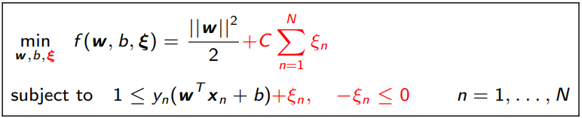
Solving Soft-Margin SVM
Recall the soft-margin SVM optimization problem
Here $ξ=\left[ξ_{1},ξ_{2},…, ξ_{N}\right]$ is the vector of slack variables
Introduce Lagrange multipliers $α_{n},β_{n}$ for each constraint and solve Lagrangian
The terms in red color above were not present in the hard-margin SVM
Two set of dual variables $α=[α_{1},α_{2},…,α_{N}]$ and $β=[β_{1},β_{2},…,β_{N}]$
Will eliminate the primal var $w$, b, $ξ$ to get dual problem containing the dual variables

Slide 4

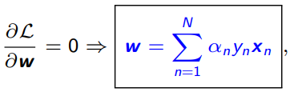


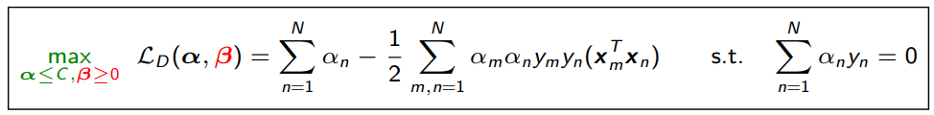

Solving Soft-Margin SVM
Note: if we ignore the bias term $b$ then we don’t need to handle the constraint $\sum_{n=1}^{N}{α_{n}y_{n}=0}$ (problem becomes a bit more easy to solve)
The Lagrangian problem to solve
Take (partial) derivatives of $ℒ$ w.r.t. $w,b$, and $ξ_{n}$ and setting to zero gives
Using $C−α_{n}−β_{n}=0$ and $β_{n}≥0$, we have $α_{n}≤C$(for hard-margin, $α_{n}≥0)$
Substituting these in the Lagrangian $ℒ$ gives the Dual problem
Otherwise, the $α_{n}$’s are coupled and some opt. techniques such as co-ordinate aspect can’t easily applied
Weighted sum of training inputs
The dual variables $β$ don’t appear in the dual problem!
Given $α$, $w$ and $b$ can be found just like the hard-margin SVM case
Maximizing a concave function (or minimizing a convex function) s.t. $α≤C$ and $\sum_{n=1}^{N}{α_{n}y_{n}=0}$. Many methods to solve it.
In the solution, $α$ will still be sparse just like the hard-margin SVM case. Nonzero $α_{n}$ correspond to the support vectors
(Note: For various SVM solvers, can see “Support Vector Machine Solvers” by Bottou and Lin)

Slide 5
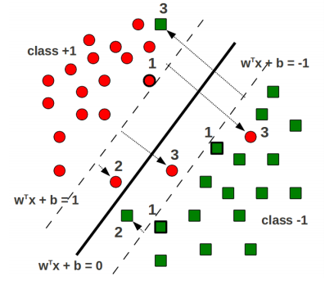

Support Vectors in Soft-Margin SVM
The hard-margin SVM solution had only one type of support vectors
All lied on the supporting hyperplanes $w^{⊤}x_{n}+b=1$ and $w^{⊤}x_{n}+b=−1$
The soft-margin SVM solution has three types of support vectors (with nonzero $α_{n}$)
Lying on the supporting hyperplanes
Lying within the margin region but still on the correct side of the hyperplane
Lying on the wrong side of the hyperplane (misclassified training examples)
(Proof left as an exercise)

Slide 6
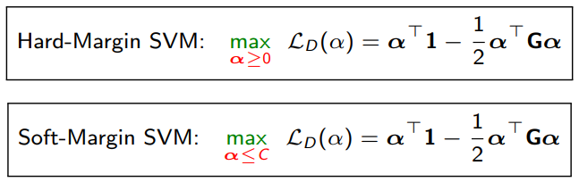
SVMs via Dual Formulation: Some Comments
Recall the final dual objectives for hard-margin and soft-margin SVM
The dual formulation is nice due to two primary reasons
Allows conveniently handling the margin based constraint (via Lagrangians)
Allows learning nonlinear separators by replacing inner products in $G_{nm}=y_{n}y_{m}{x_{n}}^{⊤}x_{m}$ by general kernel-based similarities (more on this when we talk about kernels)
However, dual formulation can be expensive if $N$ is large (esp. compared to $D$)
Need to solve for $N$ variables $α=[α_{1},α_{2}, …,α_{N}]$
Need to pre-compute and store $N× N$gram matrix G
Lot of work on speeding up SVM in these settings (e.g., can use co-ord. descent for $α$)
Note: Both these ignore the bias term $b$ otherwise will need another constraint $\sum_{n=1}^{N}{α_{n}y_{n}=0}$

Slide 7
A Co-ordinate Ascent Algorithm for SVM
Recall the dual objective of soft-margin SVM (assuming no bias $b$)
Focusing on just one of the components of $α$ (say $α_{n}$), the objective becomes
The above is a simple quadratic maximization of a concave function: Global maxima
If constraint violated, project $α_{n}$ in $[0,C]$: If $α_{n}<0$, set it to 0, if $α_{n}>C$, set it to $C$
Can cycle through each coordinate $α_{n}$ in a random or cyclic fashion
$$\underset{0≤α≤C}{argmax} \sum_{n=1}^{N}{α_{n}} − \frac{1}{2}\sum_{m,n=1}^{N}{α_{m}α_{n}y_{m}y_{n}x_{m}^{⊤}}x_{n}$$
Note that $w= \sum_{n=1}^{N}{α_{n}y_{n}x_{n}}$
Can efficiently compute it if we also store $w$. It is equal to $w^{⊤}x_{n}−α_{n}y_{n}$ ${\left\|x_{n}\right\|}^{2}$
Can compute these in the beginning itself
$\underset{0≤α_{n}≤C}{argmax} α_{n}−\frac{1}{2}α_{n}^{2 }{\left\|x_{n}\right\|}^{2} −\frac{1}{2}α_{n}y_{n}\sum_{m≠n}{α_{m}y_{m}x_{m}^{⊤}}$ $x_{n}$

Slide 8
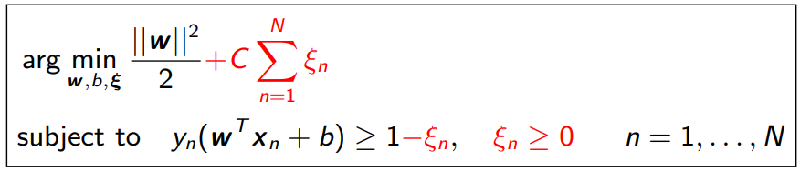
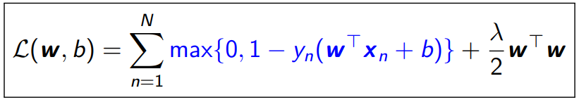
Solving for SVM in the Primal
Maximizing margin subject to constraints led to the soft-margin formulation of SVM
Note that slack $ξ_{n}$ is the same as $max\{0,1−y_{n}\left(w^{⊤}x_{n}+b\right)\}$, i.e., hinge loss for ($x_{n},y_{n}$)
Thus the above is equivalent to minimizing the $ℓ_{2}$ regularized hinge loss
Sum of slacks is like sum of hinge losses, $C$ and $λ$ play similar roles
Can learn $(w, b)$directly by minimizing $ℒ(w, b)$using (stochastic)(sub)grad. descent
Hinge-loss version preferred for linear SVMs, or with other regularizers on $w$ (e.g., $ℓ_{1})$

Slide 9
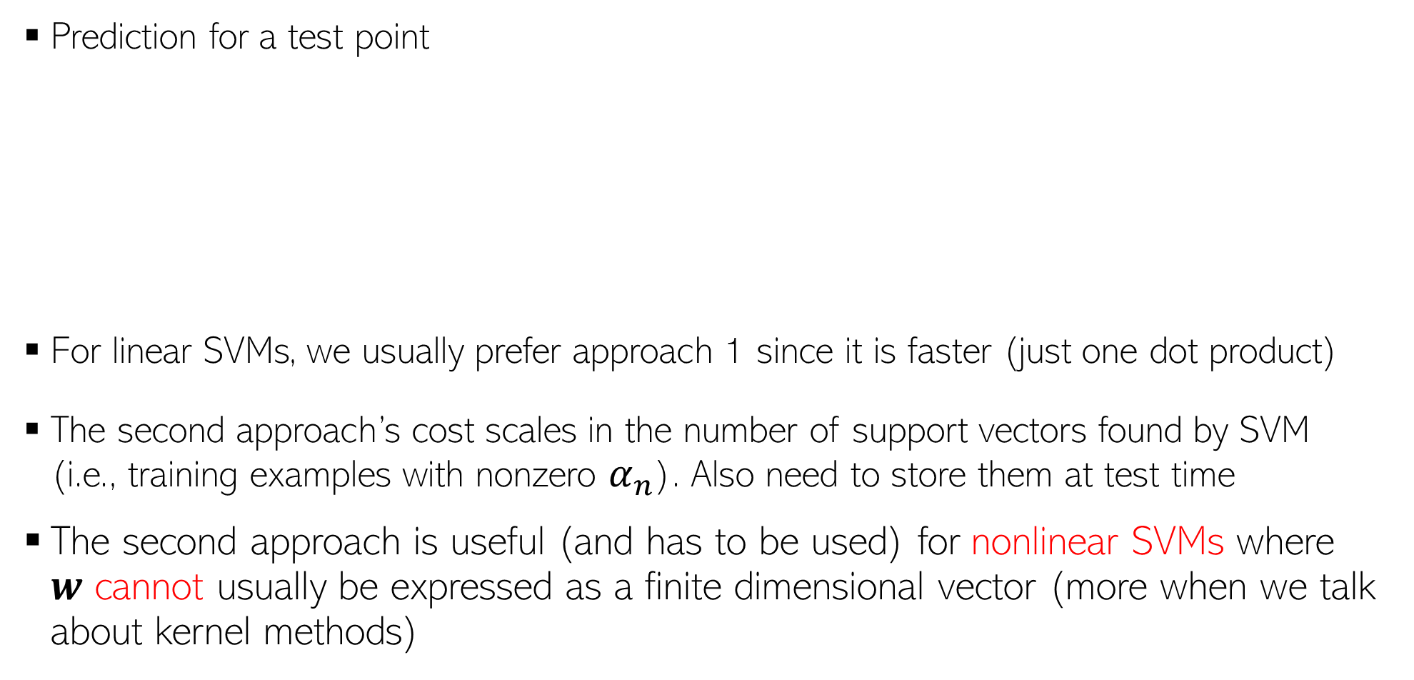
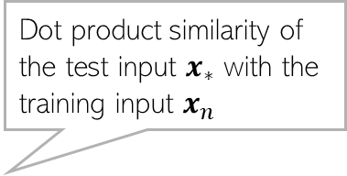
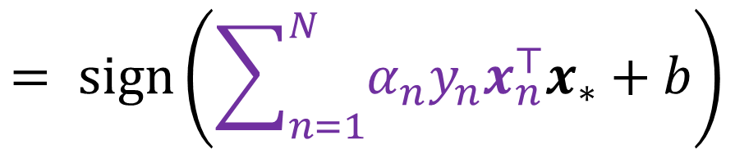

SVM: At Test Time
Prediction for a test point
For linear SVMs, we usually prefer approach 1 since it is faster (just one dot product)
The second approach’s cost scales in the number of support vectors found by SVM (i.e., training examples with nonzero $α_{n}$). Also need to store them at test time
The second approach is useful (and has to be used) for nonlinear SVMs where $w$ cannot usually be expressed as a finite dimensional vector (more when we talk about kernel methods)
$$y_{∗}=sign(w^{⊤}x_{∗}+b)$$
Dot product similarity of the test input $x_{∗}$ with the training input $x_{n}$
(Approach 1)
$$= sign\left(\sum_{n=1}^{N}{α_{n}y_{n}x_{n}^{⊤}x_{∗}}+b\right)$$
(Approach 2)

Slide 10
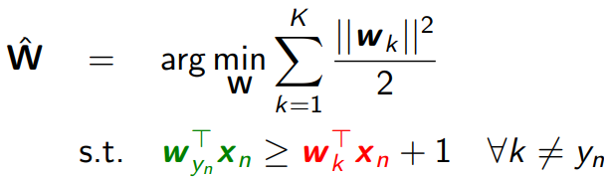
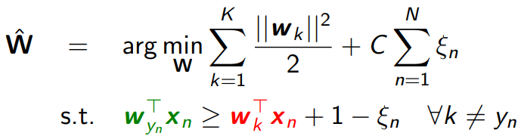
Multi-class SVM
Multiclass SVMs (assuming $K > 2$classes) use $K$ wt vectors $W = [w_{1},w_{2},…,w_{K}]$
Like binary SVM, can formulate a maximum-margin problem (without or with slacks)
The version with slack corresponds to minimizing a multi-class hinge loss
Prediction at test time:
$\hat{y_{∗}}={argmax}_{k∈\{1,2,…,K\}} w_{k}^{⊤}x_{∗}$
Score on correct class
Score on an incorrect class $k≠y_{n}$
Crammer-Singer
Multi-class SVM
$$ℒ\left(W\right)= \sum_{n=1}^{N}{max\left\{0, 1+\max_{k≠y_{n}}{ w}_{k}^{⊤}x_{n} −w_{y_{n}}^{⊤}x_{n}\right\}+ }\frac{λ}{2}\sum_{k=1}^{K}{{\left\|w_{k}\right\|}^{2}}$$
Loss=0 if score on correct class is at least 1 more than score on next best scoring class

Slide 11
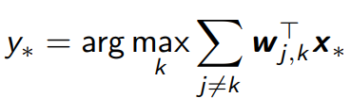
Multi-class Classification using Binary Classification
Can use binary classifiers to solve multiclass problems
One-vs-All (also called One-vs-Rest): Construct $K$ binary classification problems
All-Pairs: Learn $K$-choose-2 binary classifiers, one for each pair of classes $(j, k)$
Solid lines: one-vs-all boundaries
Dotted lines: Effective multi-class boundaries
Weight vector of the pairwise classifier for class $j$ and $k$
Whichever class $k$ wins the most over other classes (or has the largest total scores against all other classes) is the prediction
Positive score if class $k$ wins over class $j$ in pairwise comparison

Slide 12
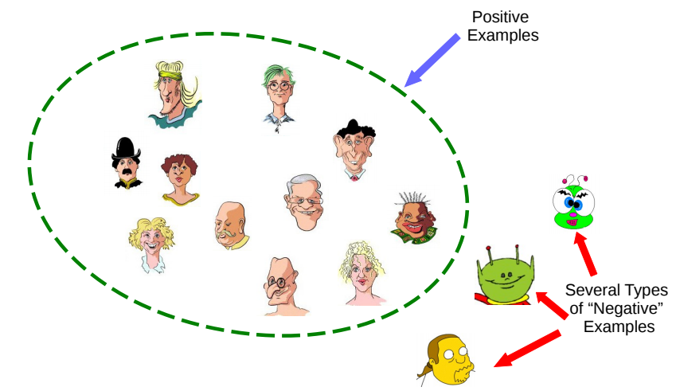
One-class Classification
Can we learn from examples of just one class, say positive examples?
May be desirable if there are many types of negative examples
One-class classification is an approach to learn using only one class of examples
“Outlier/Novelty Detection” problems can also be formulated like this
Pic credit: Refael Chickvashvili

Slide 13
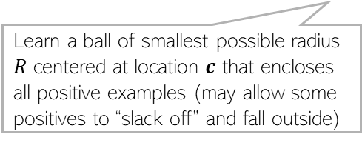
One-class Classification via SVM-type Methods
There are two popular SVM-type approaches to solve one-class problems
“One-Class SVM” (OC-SVM)
[Schölkopf et al., 2001]
“Support Vector Data Description” (SVDD)
[Tax and Duin, 2004]
Allow some slack for the positive examples
Learn a ball of smallest possible radius $R$ centered at location $c$ that encloses all positive examples (may allow some positives to “slack off” and fall outside)
Pretend that origin represents all the negative examples (note: we aren’t given any of those)
Supporting hyperplane (as in binary SVM)
Origin
Decision boundary

Slide 14
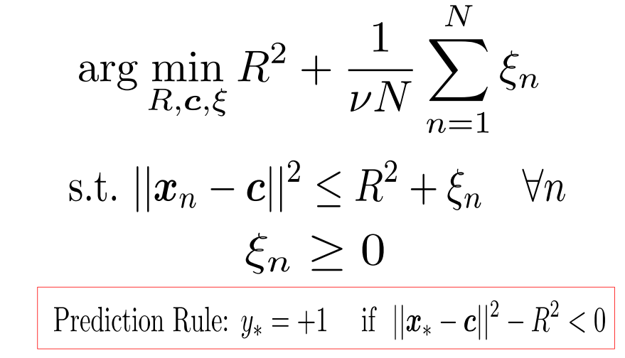
One-class Classification via SVM-type Methods
Hyperparameter $ν$ to trade-off b/w the two terms
Want to keep training error (sum of slacks) to be small
“Support Vector Data Description” (SVDD)
[Tax and Duin, 2004]
Want to keep the ball’s radius as small as possible
Want all training examples to fall within the ball (up to some slack $ξ_{n}$)

Slide 15
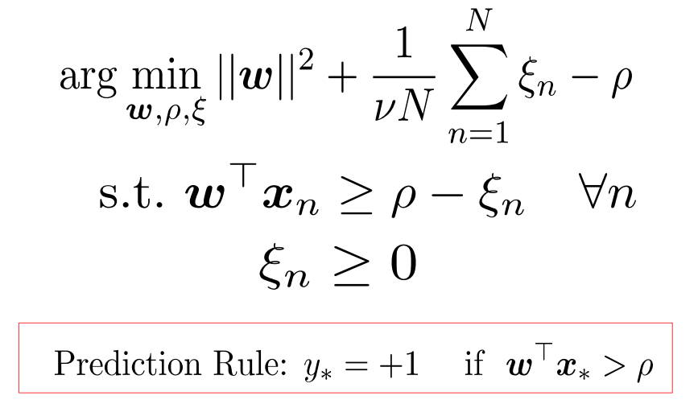
One-class Classification via SVM-type Methods
“One-Class SVM” (OC-SVM)
[Schölkopf et al., 2001]
Want to keep training error (sum of slacks) to be small
Maximize the margin (similar to binary SVM)
An offset term (want it large)
Want a sufficiently large score (say $ρ$)
Origin

Slide 16
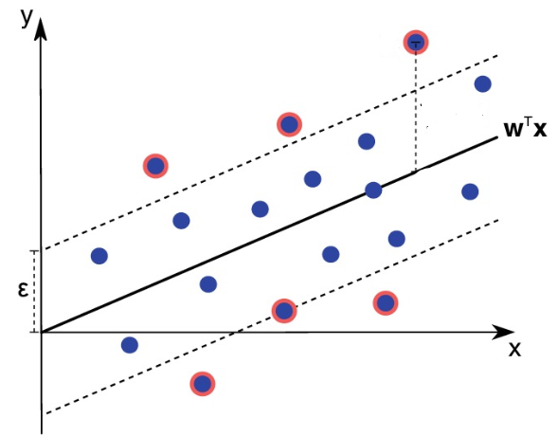
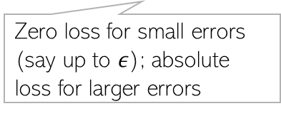



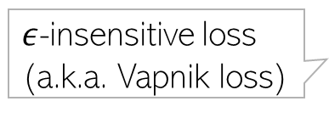


Support Vector Regression (SVR)
SVR is an SVM variants for regression problems
SVR uses $ε$-insensitive loss for regression
Like the classification case, SVR also leads to a constrained optimization problem
Loss
$${|y}_{n}−f\left(x_{n}\right)|−ε$$
$ε$-insensitive loss
(a.k.a. Vapnik loss)
Zero loss for small errors (say up to $ε$); absolute loss for larger errors
$$−ε$$
$$ε$$
${y_{n}− f(x}_{n}$)

Slide 17
Next class
Nonlinear learning via Kernel Methods

